Slide 1
Hacking Rails
@jimmynguyc

Slide 2

Why?
http://phrack.org/

Slide 3
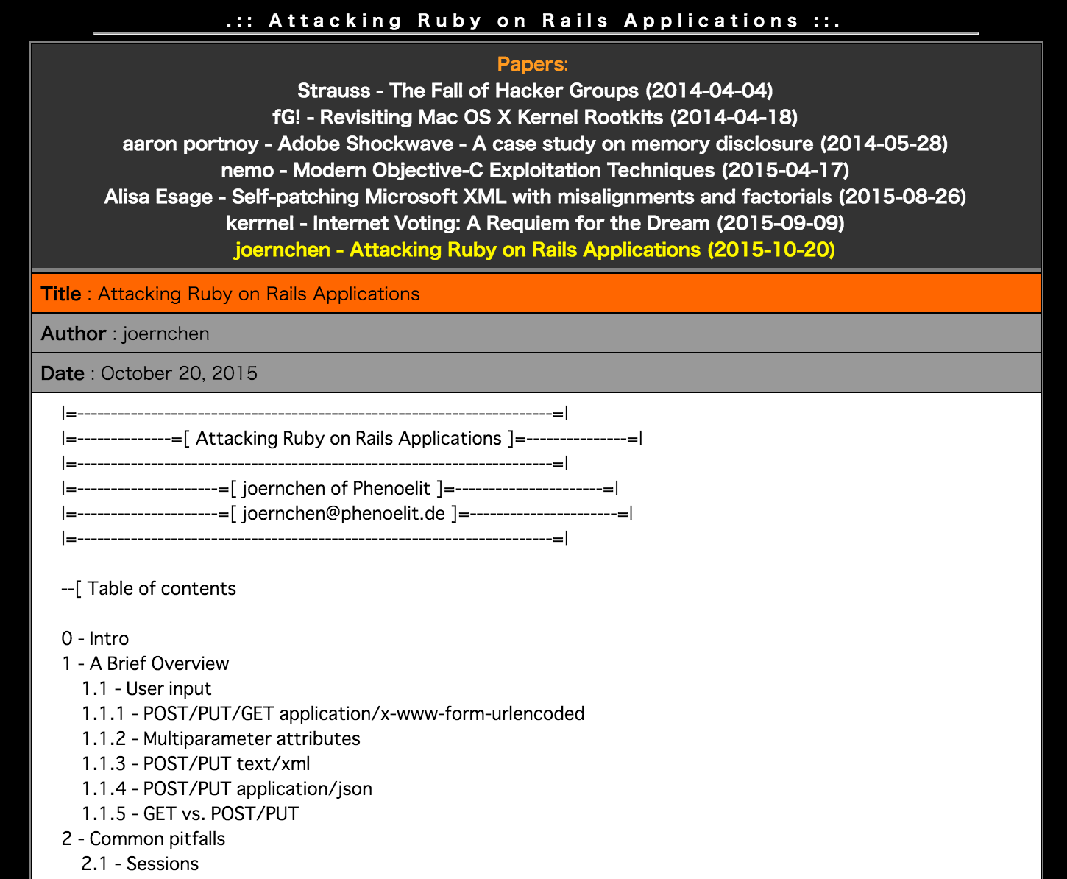

Slide 4
Ruby on Rails
MVC based web application framework
Convention over Configuration (CoC)
Easy to learn
Magical 😇

Slide 5
Ruby on Rails
Created by David Heinemeier Hansson (DHH)
Extracted from Basecamp
First release in 2004

Slide 6
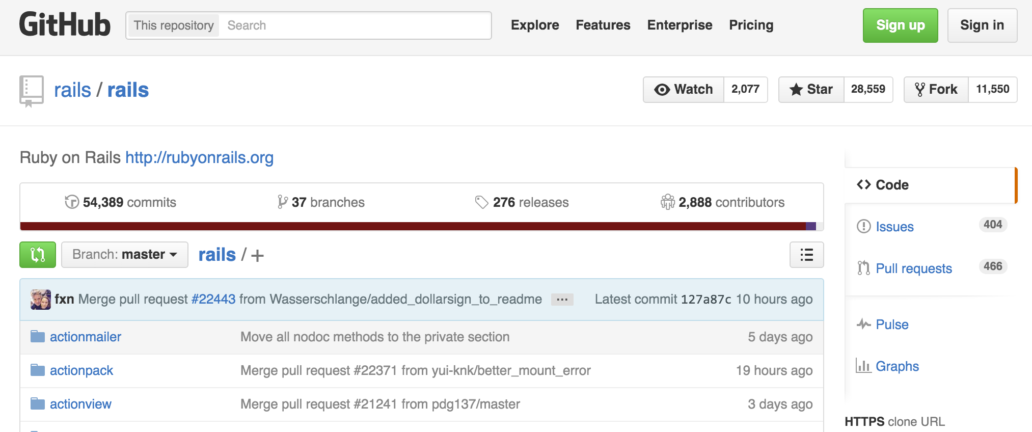
Ruby on Rails
@ 29-11-2015

Slide 7
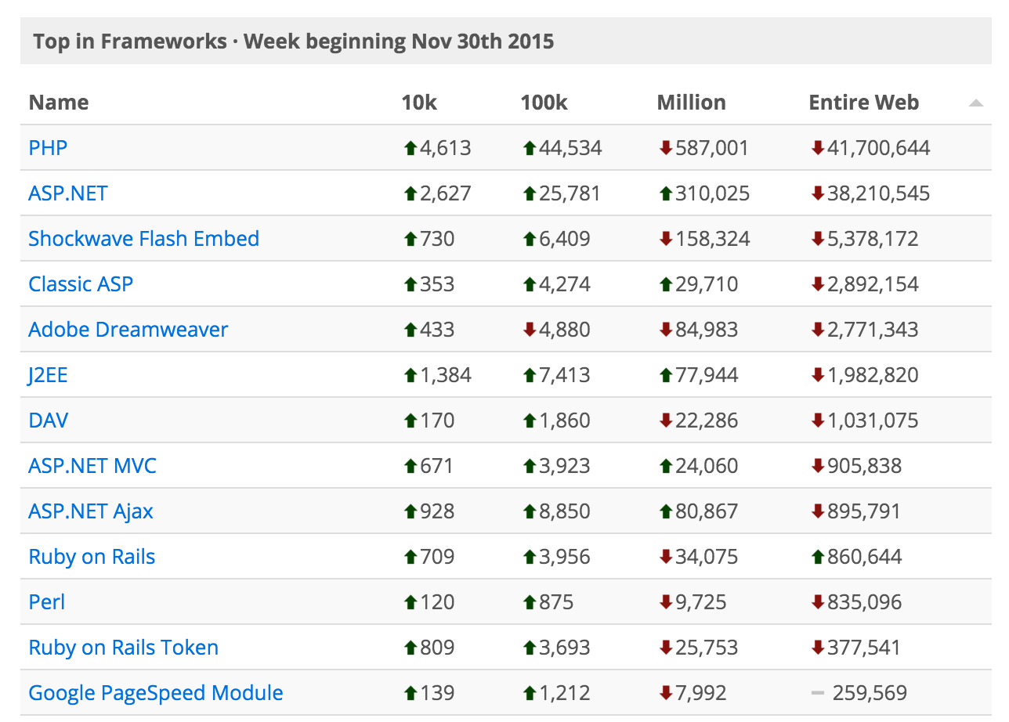

Ruby on Rails
#7
1,238,205
#10
source: buildwith.com

Slide 8

Ruby on Rails
More Usage = Bigger Target for Hackers

Slide 9
CVE
Dictionary of Common Vulnerabilities and Exposures (CVEs)

Slide 10
# of CVEs
source: cvedetails.com

Slide 11
CVSS Scores
Common Vulnerability Scoring System
0 to 10
Based on 3 metric groups (base, temporal & environmental)
Describes severity

Slide 12
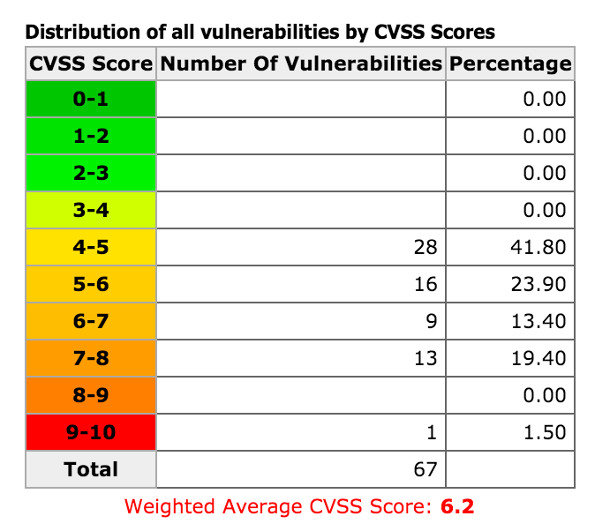
CVSS Scores
source: cvedetails.com

Slide 13
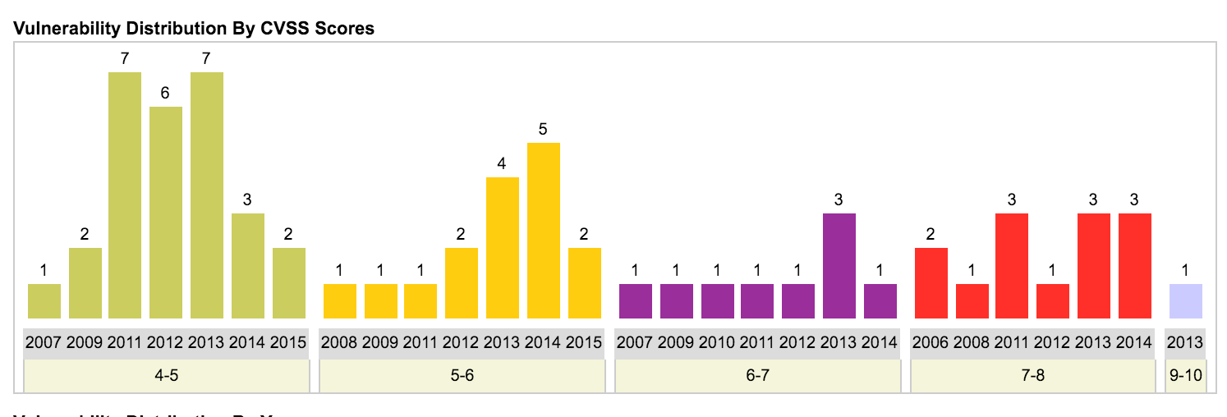
CVSS Scores
source: cvedetails.com

Slide 14
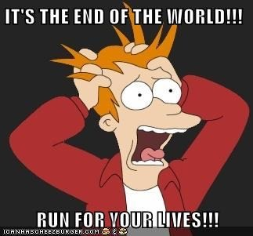

Slide 15
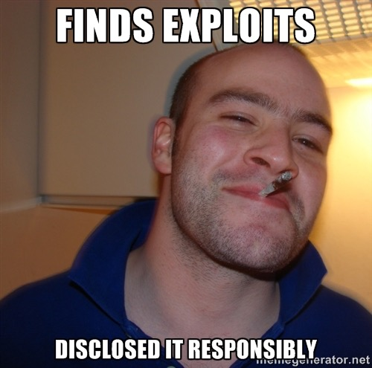
Responsible Disclosure

Slide 16
Responsible Disclosure
All stakeholders agrees to allow a period of time for the vulnerability to be patched before publishing the details
E.g. “Ruby on Rails: Security” Google Group

Slide 17
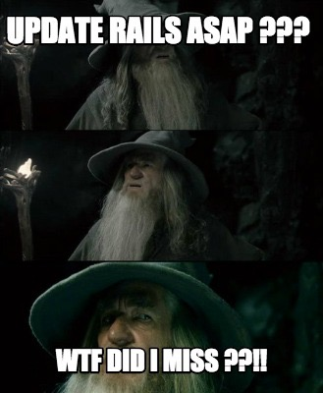

Slide 18
Let’s Learn Something Instead

Slide 19
Disclaimer
I am not responsible for any shenanigans that
you might partake in as a direct or indirect result
of the information that I’m about to tell you.

Slide 20
Approach
Understand the exploit
Look at the codes responsible
Demo
Understand the patch

Slide 21

Penetrating Testing Software

Slide 22
CVE-2013-0333
CVSS 7.5
Execute Code / Sql Injection / Bypass a restriction or similar
Allows YAML to be loaded via JSON payload
Basically exploiting YAML::load(yaml)

Slide 23
Code Responsible
lib/action_dispatch/middleware/params_parser.rb
lib/active_support/json/decoding.rb
lib/active_support/json/backends/yaml.rb

Slide 24
Demo

Slide 25
Patch
https://groups.google.com/forum/#!searchin/rubyonrails-security/2013-0333/rubyonrails-security/1h2DR63ViGo/GOUVafeaF1IJ

Slide 26
CVE-2013-0156
CVSS 7.5
Denial Of Service / Execute Code
Allows YAML to be loaded via XML payload
Exploiting YAML::load(yaml) ... again

Slide 27
Code Responsible
lib/action_dispatch/middleware/params_parser.rb
active_support/core_ext/hash/conversions.rb
active_support/xml_mini.rb

Slide 28
Demo

Slide 29
Patch
https://groups.google.com/forum/#!searchin/rubyonrails-security/CVE-2013-0156/rubyonrails-security/61bkgvnSGTQ/nehwjA8tQ8EJ

Slide 30
DeviseDoor
joernchen/DeviseDoor

Slide 31
What Now?
gem install brakeman
Code Climate
Read & subscribe to security blogs
Good coding practices

Slide 32
Q&A

Slide 33
Thank you :)

